Slide 1

Vivir más, Asegurar mejor El reto de la Longevidad
Evento Grupo LARG
Bryan Urbano
Septiembre 2025

Slide 2
Comencemos con una pregunta…
¿Hasta a qué edad te
gustaría vivir?

Slide 3
Resultados…
De los 83 que respondieron mi encuesta:
> 90
6.06%
< 60 9.09%
65 6.06%
90
9.09%
70
15.15%
78
85
6.06%
80
27.27%
75
21.21%

Slide 4
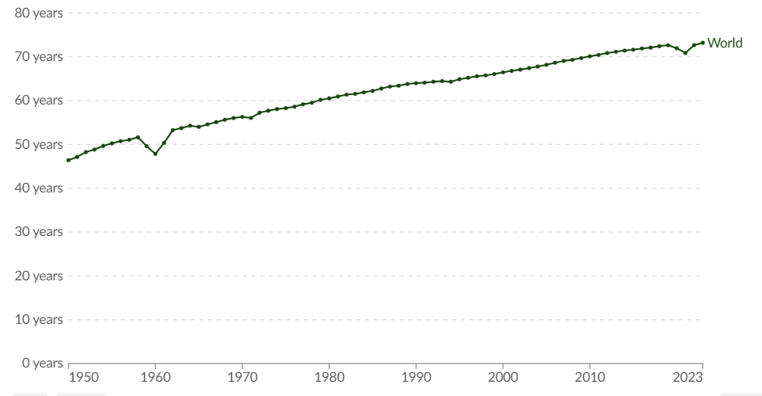
¿Cómo se ha comportado la esperanza de vida?
78
73

Slide 5
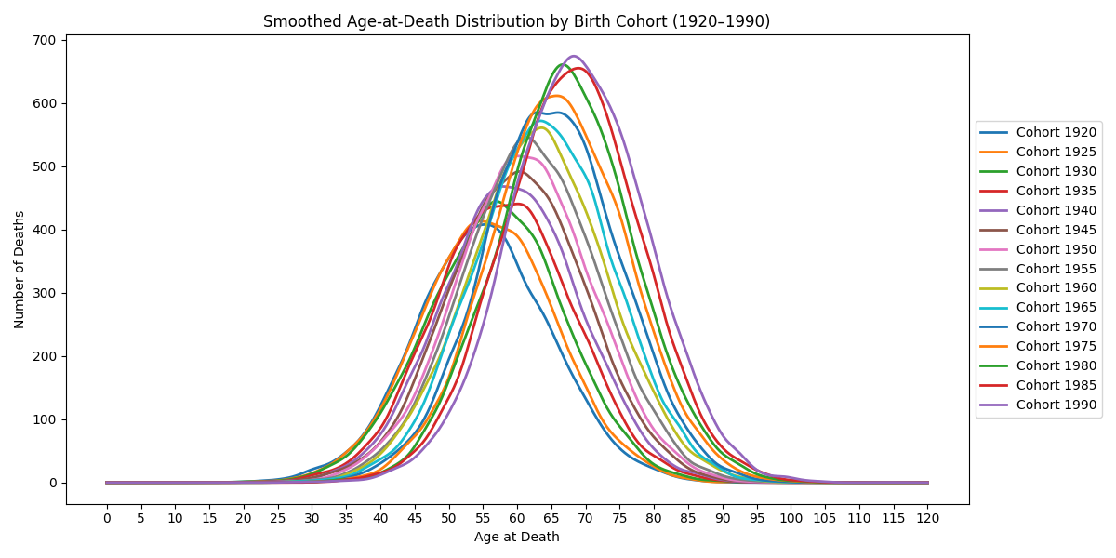
Mortalidad por Cohortes
Aplazamiento de Mortalidad
78

Slide 6
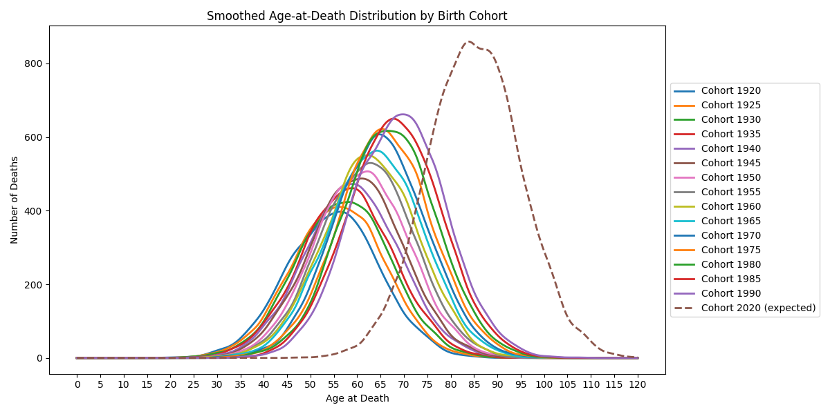
Mortalidad por Cohortes
78

Slide 7
Hechos en la Mortalidad
78
Variables biológicas intrínsecas
Dimensión social
Notes:
Mortality statistics are driven by underlying biology, not just past trends, andassuming a fixed 2% annual decline in death rates is likely to significantlyoverestimate future life expectancy, especially in the United States.
Mortality statistics are driven by biology, not just past statistical trends. Therefore,using linear extrapolations of historical data to predict future mortality is flawed.
An 87-year longitudinal study was referenced, which concluded that biology is notthe sole determinant of successful aging. Social dimensions are equally critical, withthe study suggesting that happiness at 80 can be predicted by social interaction andquality of life at 50.

Slide 8
Hechos en la Mortalidad
78
Variables biológicas intrínsecas
Dimensión social
Notes:
Mortality statistics are driven by underlying biology, not just past trends, andassuming a fixed 2% annual decline in death rates is likely to significantlyoverestimate future life expectancy, especially in the United States.
Mortality statistics are driven by biology, not just past statistical trends. Therefore,using linear extrapolations of historical data to predict future mortality is flawed.
An 87-year longitudinal study was referenced, which concluded that biology is notthe sole determinant of successful aging. Social dimensions are equally critical, withthe study suggesting that happiness at 80 can be predicted by social interaction andquality of life at 50.

Slide 9
Hechos en la Mortalidad
No linearidad
78
Variables biológicas intrínsecas
Dimensión social
Panorama
Económico
Notes:
Mortality statistics are driven by underlying biology, not just past trends, andassuming a fixed 2% annual decline in death rates is likely to significantlyoverestimate future life expectancy, especially in the United States.
Mortality statistics are driven by biology, not just past statistical trends. Therefore,using linear extrapolations of historical data to predict future mortality is flawed.
An 87-year longitudinal study was referenced, which concluded that biology is notthe sole determinant of successful aging. Social dimensions are equally critical, withthe study suggesting that happiness at 80 can be predicted by social interaction andquality of life at 50.

Slide 10
Panorama
78
18%
Personas mayores de 65
Hoy
Para el 2054
23%
Personas mayores de 65

Slide 11
Spans
78
79 años
≠
63 años
Lifespan
Healthspan
Industrias Financieras
Notes:
Lifespan refers to the total number of years a person lives, from birth to death. Healthspan is a concept that focuses on the number of those years that a person remains free of significant illness or disease.

Slide 12
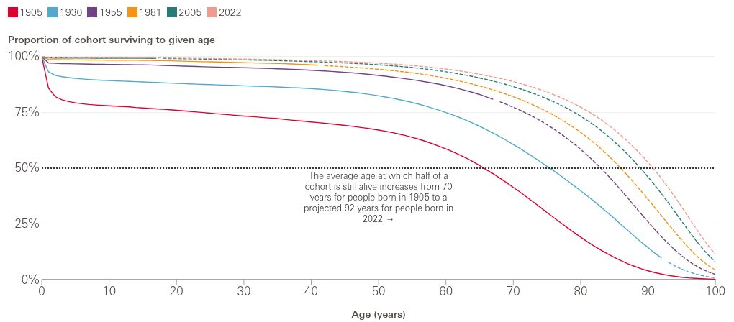
En términos de supervivencia
78

Slide 13
Spans en Costo
78
Canadá
Europa
~ 5x
US
Riesgo de Longevidad
Catástofes naturales
Notes:
Si lo vemos en precio
El precio de las edades avanzadas 5 veces mayor que la de una catastrophe natural promedio
Quién lo va a pagar?

Slide 14
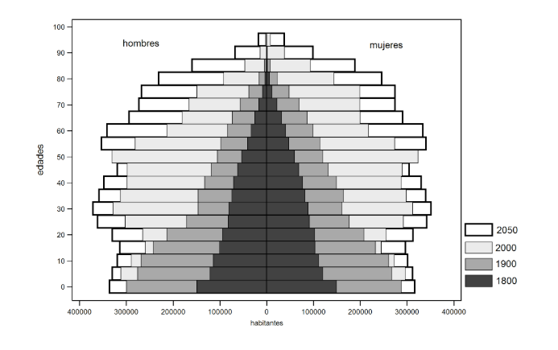
Pirámide Poblacional
78
Notes:
The Total Fertility Rate (TFR), or the total number of babies per woman, hasdeclined dramatically in many parts of the world, with a replacement rate of 2.1.South Korea’s TFR, for example, is close to 0.7.
Despite falling TFRs, the global population is still projected to rise from 8.5 billion toat least 10 billion people by mid-century due to demographic momentum (pasttrends in fertility and larger growing age structures). Predictions of populationcollapse are considered unfounded, and “cockamamie schemes” like Singapore’s“love cursers” to raise fertility have failed.
The decline in fertility is strongly associated with the education of women, a trendthat is unlikely to be reversed.
Increasing fertility rates is not a short-term solution to demographic challenges, as itwould take over 20 years before new children enter the workforce, temporarilyincreasing the dependency ratio.

Slide 15
Pirámida poblacional
78
Por cada, persona mayor a los 65
1950
12 PEA
2040
4 PEA
Notes:
12 trabajadores por cada persona arriba de los 65 y ahora bajo a 4
Se refleja en nuestras economias

Slide 16
¿Qué podemos esperar?
78
1
Entorno social
2
Impacto en 20 años
3
Descubrimientos e Investigaciones
4
Esperanza de Vida Proyectada
Notes:
Reevaluación Socioeconómica
Revisar estructuras y sistemaspara acomodar el incremento en población mayor que vive major
There is a pressing need for people to work more years to ensure economicsustainability. In Europe, people work for an average of about 28 years betweenages 15 and 65, which is economically unsustainable for a lifespan of 80 years.
Impacto en 20 años
Como se preveé que la Esperanza de vida crezca se debe planear en las esferas de salud, seguros y estrategia fianciera
Descubrimientos e Investigación
Medicina regenerative, terapias geneticas y biotecnología que puedan incrementar la Esperanza de vida
Esperanza de vida proyectada
Si sigue la tendencia lpodría crecer y tener más personas que puedan vivr más años

Slide 17




Tendencias
Titeltext löschen, sonstigen Text + Elemente bitte stehen lassen, komplett nach EE -> 1x
78
Descubrimeinto de Fármacos
Regeneración de partes
Cambios en Procesos Celulares
Anti - aging

Slide 18




¿Cómo afecta a las aseguradoras?
Seguros de Vida
Manejo de Capital
Placeholder
Redefinición
Placeholder
Seguros de Salud
Pensiones
Placeholder
Placeholder
Notes:
Seguros de vida: Valores asegurados no se adaptan
Seguros de salud: Más caro, más tratamientos, más examenes, cambios regulatorios
Wealth management: Como viven más, deberían usar sus recursos. Trabajar más años y guardar más dinero (mejorar inversions)
Pensiones: Podría resultar insuficiente y las ocmpañías sin capital para pagarlas.

Slide 19





El reto para las aseguradoras
78
Análisis
De
Datos
Prevención
y
Wellness
Impacto
Financiero
Cambios laborales
Proacción
Notes:
La prevención, con aydua de AI y an´´alisis de datos
The traditional insurance model is reactive, paying for costs after an accident orillness occurs, relying on old actuarial data. There is a need to shift to a proactive,preventive model, as “prevention equals data, and data equals AI.”
This shift requires leveraging new types of data beyond traditional actuarial tables,such as genomic, multiomic, metabolic, life environment, mental health, and fitnessdata.
Cambio de mentalidad. Ser proactivos en vez de reactivos
Redesign the working place
It was suggested that the term “retirement age” should be replaced with “statepension age” to reflect that it is not a mandatory age to stop working.
To encourage people to stay in the workforce longer, the nature of work itself needsto be re-evaluated.
The modern hybrid workplace can become transactional and lack the spontaneous,enjoyable interactions that contribute to job satisfaction, potentially making work“miserable.”

Slide 20
30 años de experiencia
€40.000m
€6.000m
78
Pasivos de bloques de pensiones (en EUR)
Pasivos de rentas individuales (en EUR)
Nuestra base de datos de longevidad: >4m pólizas, 18,5m años de exposición y 550k fallecidos
Notes:
... split in pension block liabilities and underwritten annuity liabilities
Our wealth of experience is substantiated by a database of more than 4 million policies, over 18 million years of exposure and over 550,000 deaths. For comparison: Half of the portfolios we’ve underwritten have less than 1,600 deaths which gives us a substantial advantage for risk assessment compared to a single insurer or pension scheme.

Slide 21
Entonces…
¿Hasta a qué edad te
gustaría vivir?
78

